Slide 1


Slide 9
Medicare: Generally
1965 – created and given to those 65 and over
1972 – expanded to those under 65 with certain permanent disabilities.
Today – Medicare provided to 59 million Americans.
The program pays for
Medicare accounts for 15% of total federal spending in 2016 and 20% of total national health spending in 2015.
Hospitalizations physician visits prescription drugs post-acute care | skilled nursing facility care home health care hospice care, and preventive services.

Slide 10
Medicare: Who is Eligible?
Over 65: entitled to Medicare Part A if they or their spouse are eligible for Social Security payments and have paid payroll taxes for 10 or more years.
Under 65:
Waiting Period: Social Security Disability Insurance (SSDI) recipients generally become eligible after a 2 year waiting period.
Qualifying Medical Conditions Without Waiting Period: those individuals diagnosed with end state renal disease (ESRD) and amyotrophic lateral sclerosis (ALS).

Slide 11
Medicare: What is Covered
Medicare covers many basic health services. These include: hospital stays, physician services, and prescription drugs.
Traditional Medicare
Medicare Part A
Medicare Part B
Drug Benefit Program:
Medicare Part D
Medicare Advantage Program
Medicare Part C

Slide 12
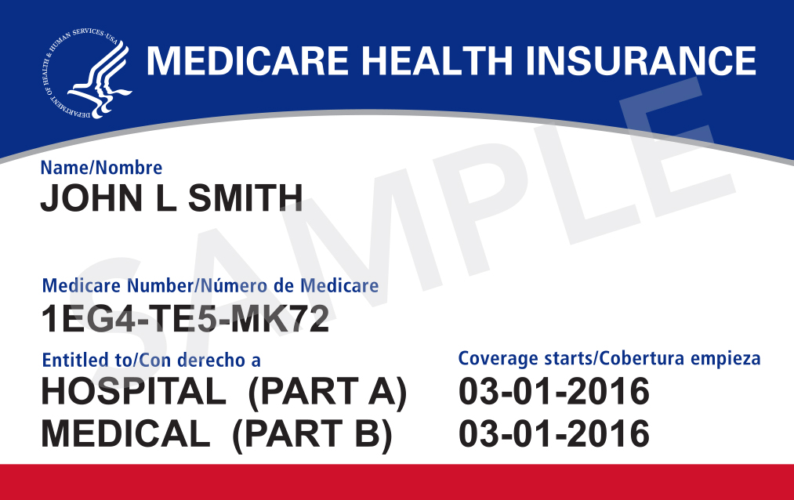
Traditional Medicare
also known as:
Original Medicare
Fee For Service Medicare

Slide 13
Medicare Part A:
What is Covered:
Inpatient hospital stays
Skilled nursing facility stays
Home health visits (with limitations)
Hospice care
Deductibles and Coinsurance:
Part A benefits are subject to a deductible (2018: $1,340 per benefit period).
Co-Insurance: beneficiaries are subject to coinsurance amounts for extended inpatient stays in hospital or skilled nursing facility.
How Are Providers Paid: Providers are paid on a fee for service basis pursuant with their contracts with CMS.

Slide 14
Medicare Part B:
What is Covered:
Physician visits
Outpatient services
Preventative services
Home health visits (with limitations)
Deductibles and Coinsurance:
Part B benefits are subject to a deductible (2018: $183.00)
Co-insurance: Most Part B benefits are subject to 20% coinsurance
No coinsurance or deductible is charged for: wellness visits; or certain preventative services
How Are Providers Paid: Providers are paid on a fee for service basis pursuant to their contracts with CMS.

Slide 15
Medicare Part D:
Medicare Part D is a voluntary benefit that helps enrollees pay drug costs after a deductible is met and offers catastrophic coverage for very high drug costs.
Covers: Outpatient prescription drugs through private plans that contract with Medicare, including both standalone prescription drug plans (PDPs) and Medicare Advantage drug plans (MA-PD plans);
Cost to Beneficiary: Enrollees pay monthly premiums and cost sharing for prescriptions, with costs varying by plan, and those who do not receive low-income subsidies pay 5 percent of total drug costs after reaching the catastrophic coverage threshold.
Additional financial assistance is available for beneficiaries with low incomes and modest assets.

Slide 16
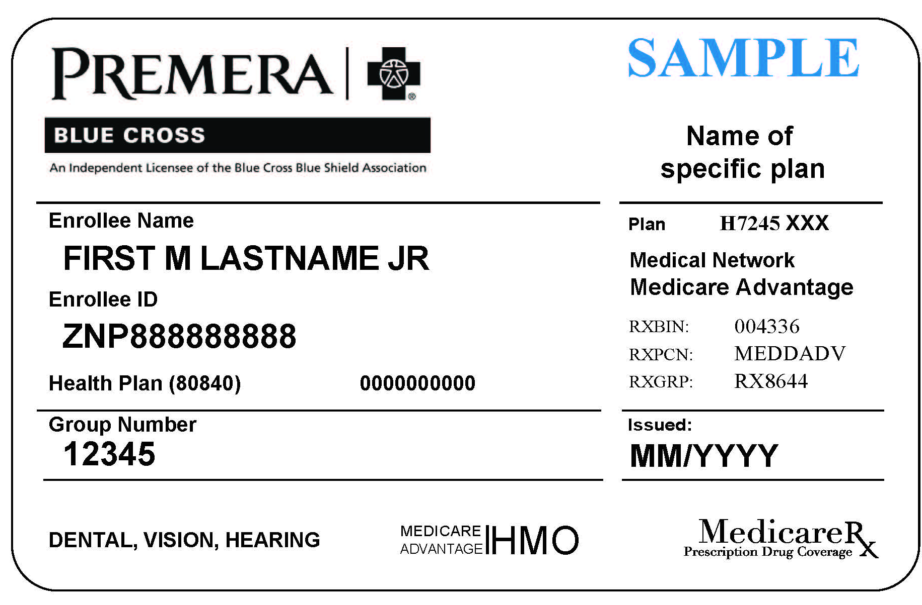
Medicare Advantage
also known as:
Medicare Part C
Medicare Advantage Organization (MAO)
Medicare Advantage Plan
(MA Plan)

Slide 17
Medicare Part C:
Medicare Advantage Organization (MAO): a private entity that provides Medicare benefits.
Examples include:
United Healthcare
Humana
Cigna
Anthem
Blue Cross Blue Shield
Emblem Health
Summacare
First Tier Entity: is any private entity that contracts with an MAO to provide administrative services or health care services for said MAO. See 42 C.F.R. §§ 422.500; 423.501.

Slide 18
Medicare Part C:

Slide 19
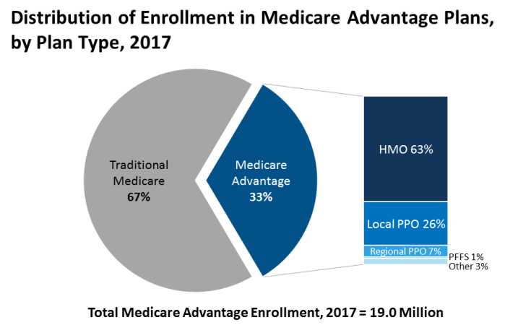
Medicare Advantage Program
Refers to the Medicare Advantage program through which beneficiaries can enroll in private health plans, such as Health Maintenance Organizations (HMOs), or Preferred Provider Organizations (PPOs). Medicare Part C covers all Medicare-covered Part A and Part B benefits and typically Part D benefits. Providers are paid on a capitated basis.

Slide 20
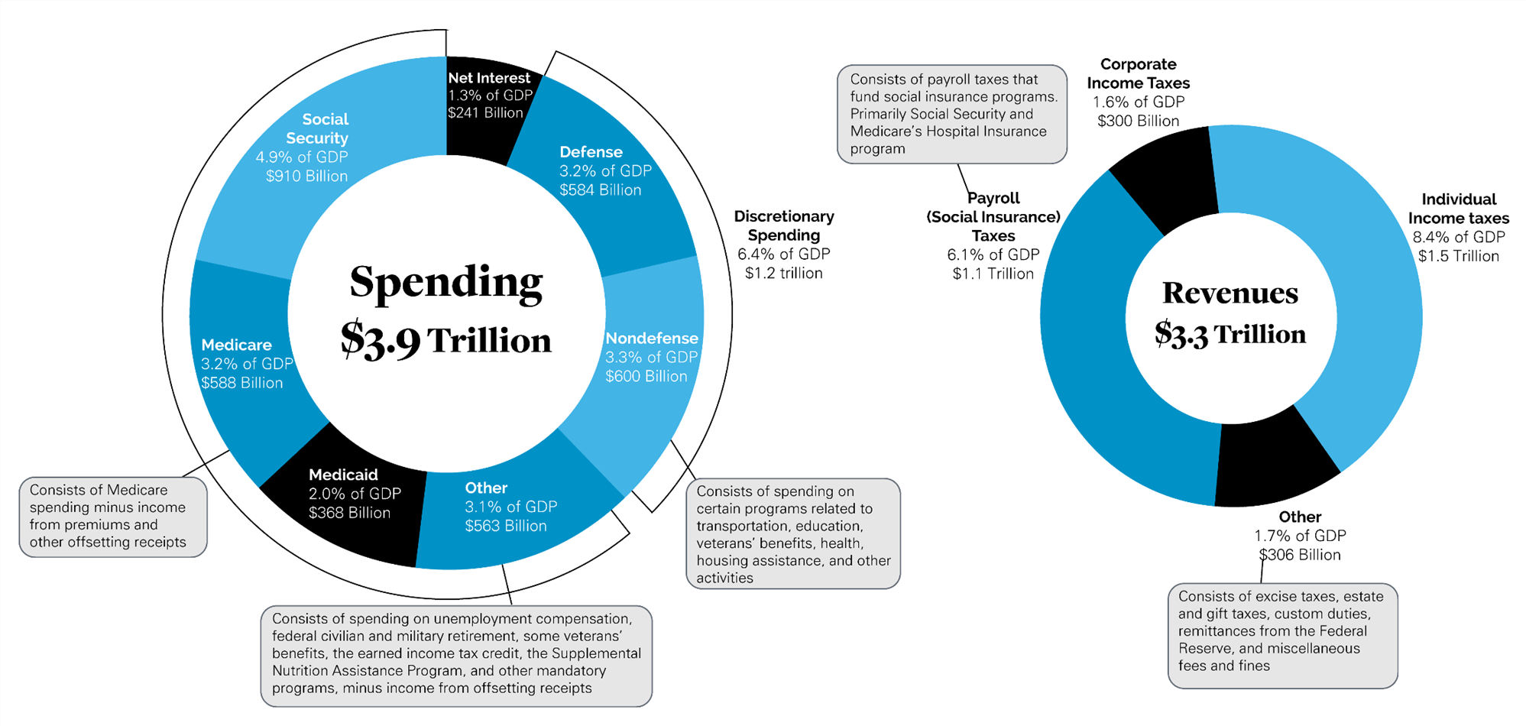
The U.S. Federal Budget In 2016

Slide 21
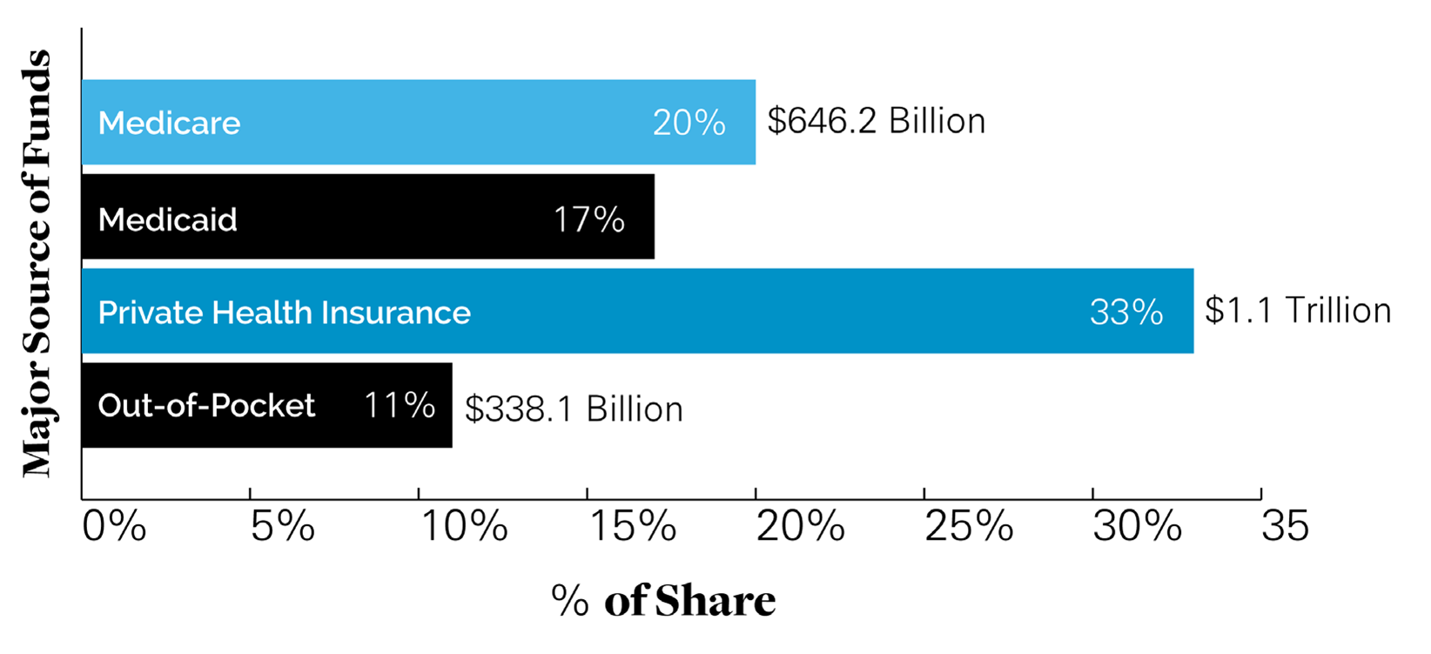
Health Spending By Major Sources Of Funds

Slide 22
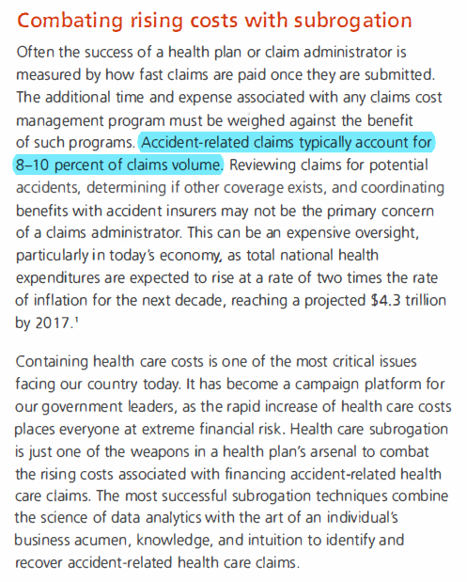


Slide 23
Timeline

Slide 27
Medicare Enacted - 1965
“Medicare was enacted as Title XVIII of the Social Security Act.”
42 U.S.C. §§1395-1395ccc, subchapter XVIII, chapter 7, Title 42.
MSP Act Created - 1980
“Medicare costs are rising. In 1980, Congress enacted the Medicare Secondary Payer Act to counteract the growth of these costs.”
Omnibus Budget Reconciliation Act of 1980, Pub. L. No. 96-499, 94 Stat. 2599, 2682 (Dec. 5, 1980).
Medicare Advantage Created - 1997
“To stimulate experimentation and innovation that would ultimately create a more efficient and less expensive Medicare system.”
Balanced Budget Act of 1997, H.R. Rep. No. 105-217

Slide 31
U.S. v. Baxter, 345 F.3d 866 (11th Cir. 2003)
“Between two sources of coverage, the insurer that pays second is in the superior position to prevent an erroneous or misdirected payment. The first payer can avoid such an outcome only by refusing to pay at all. Congress foreclosed that option in 42 U.S.C. §§ 1395y(b)(2)(A) and (b)(2)(B) by providing for Medicare to pay first where payment from the primary insurer was not reasonably forthcoming. When Medicare pays, therefore, it is paying “in the dark” – it does not know, and cannot know, whether someone else will pay. By contrast, when the primary insurer later pays, Medicare’s prior payment will normally be a matter of ascertainable fact.”
345 F.3d 866 at 901.
Pleading an MSP Claim
“Because the statute is built on the recognition that Medicare frequently will not know which of its payments [and/or insurance coverage] has been subsequently duplicated by an insurer, it would – in this unique setting of a class action involving thousands of claimants – defeat the purpose of the statute to require that the Government identify each patient, procedure, and payment amount at the pleading stage without benefit of discovery.”
345 F.3d 866 at 885.

Slide 32
United Seniors Association, Inc. v. Philip Morris
January 2006
Senator Grassley, as an amicus curiae, sought to oppose a motion to dismiss. Defendant´s motion to dismiss should be denied, as it distorted Congressional legislation and the Medicare Secondary Payer law regime.
“the very purpose of the MSP regime … is to maintain the ongoing viability of the Medicare system” and that the purpose of the MMA “was to clarify that … tortfeasors, like health or liability insurance carriers, must be primary payers before Medicare picks up the tab.”
Mandatory MSP Reporting Implemented - 2007
This Federal Code implemented in 2007 requires liability, no fault, and workers’ compensation insurance plans to report to the Federal Government every instance where a health plan has paid for a medical expense where another insurer should have paid.
42 U.S.C. §§ 1395y(b)(7)- (9).

Slide 33
Bio-Medical v. Central States (6th Cir. 2011)
“The [MSP] Act turns this natural information asymmetry to Medicare’s advantage. It empowers healthcare providers to sue private insurers who violate the Act. It then enables Medicare to pursue its reimbursement out of the proceeds recovered by the victorious healthcare providers.”
656 F.3d 277 at 296.
“Congress enabled healthcare providers to recover double damages to motivate them to bring lawsuits that, in the end, vindicate Medicare’s interests.”
656 F.3d 277 at 296.

Slide 34
In re: Avandia, 685 F.3d 353 (3d Cir. 2012)
“The plain language of [42 C.F.R. § 422.108] suggests that the Medicare Act treats MAOs the same way it treats the Medicare Trust Fund for purposes of recovery from any primary payer. In this circumstance, we are bound to defer to the duly-promulgated regulation of CMS”
685 F.3d 353 at 366.
“when MAOs spend less on providing coverage for their enrollees, as they will if they recover efficiently from primary payers, the Medicare Trust Fund does achieve costsavings”
685 F.3d 353 at 365.
“MAOs can recover from primary payers efficiently with a private cause of action for double damages does indeed advance the goals of the MA Program.”
685 F.3d 353 at 365.

Slide 35
1st Client: Florida Healthcare Plus - April 2014
MSP Recovery’s predecessor entity, La Ley Recovery Systems, signs its first agreement with an MAO, Florida Healthcare Plus (“FHCP”).
MSP Recovery Created – July 2014
First Lawsuit Filed - July 2014
MSP Recovery files its first lawsuit against a primary payer, Allstate, in Florida state court.

Slide 36
2nd and 3rd Clients: MCCI and I.M.C. - December 2014
MSP Recovery signs its 2nd and 3rd agreements with MCCI and Interamerican Medical Centers (“IMC”).
Duane Morris Law Firm MSP Opinion Letter - January 2015
Christopher Crosswhite of Duane Morris provides an opinion on MSP law.

Slide 37
Mintz, Levin Law Firm - January 2015
A team of attorneys at the law firm of Mintz, Levin, Cohn, Ferris, Glovsky and Popeo, P.C. are hired to vet MSP Recovery’s business model and the MSP law.
Holland & Knight Law - April 2015
MSP Recovery retains Maria Currier, from Holland & Knight, to analyze its assignment agreements with its assignors.

Slide 38
FTI’s Analysis of MSP Recovery’s Data - December 2015
FTI spends several weeks auditing MSP Recovery’s data.
Acknowledgment Letters - February 2016
MSP Recovery transmits assignment acknowledgement letters to its assignors to reconfirm that they have assigned all of their recovery rights to MSP Recovery.

Slide 39
KPMG Evaluates MSP Recovery’s Data - May 2016
KPMG spends several weeks auditing MSP Recovery’s data.
State of Florida Audits MSP Recovery’s Data - May-June 2016
State of Florida personnel spent several weeks auditing MSP Recovery’s data in connection with MSP Recovery purchasing claims from the State. The State approves MSP Recovery’s purchase of said claims after the audit.

Slide 40
Humana v. Western Heritage (11th Cir. 2016)
August 8, 2016
MSP Recovery Prevails as an Amicus.
“We conclude that paragraph (3)(A), the MSP private cause of action, permits an MAO to sue a primary plan that fails to reimburse an MAO's secondary payment…”
[A] “a plaintiff is entitled to summary judgment on a § 1395y(b)(3)(A) claim when there is no genuine issue of material fact regarding (1) the defendant’s status as a primary plan; (2) the defendant's failure to provide for primary payment or appropriate reimbursement; and (3) the damages amount.”
“Western also disputes the damages amount . . . . Before Western settled with the Reales, Humana issued to Ms. Reale an Organization Determination for $19,155.41. Ms. Reale was entitled to administratively appeal that amount but did not. See 42 U.S.C. § 1395w-22(g). The amount that Humana may recover is therefore fixed, at least as to Ms. Reale.”

Slide 41
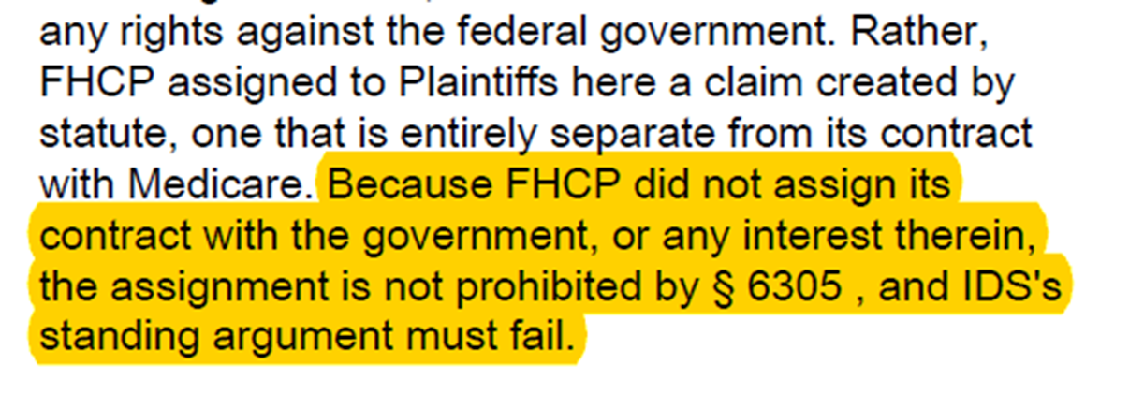
MSP Recovery v. Allstate (11th Cir. 2016)
August 30, 2016
“The regulations explicitly list the means by which responsibility for payment may be demonstrated, including a judgment or “other means, including but not limited to a settlement, award, or contractual obligation.” Id. § 411.22(b). The regulations thus specifically permit demonstration of responsibility by means of a contractual obligation”
“FHCP assigned to Plaintiffs here a claim created by statute, one that is entirely separate from its contract with Medicare. Because FHCP did not assign its contract with the government, or any interest therein, the assignment is not prohibited by § 6305, and IDS's standing argument must fail.”

Slide 42
Evidentiary Hearing - September 26-27, 2016
Judge Antonio Arzola recognizes that automobile insurers have a problem, as they fail to properly identify and repay Medicare properly.
“this is a system that is - - the way its set up, its bound for failure . . .
I mean, its like there doesn’t seem to be any
communication or coordination at all. It’s - -
I don’t know. I mean, it sounds like a disaster . .
- Judge Arzola

Slide 43
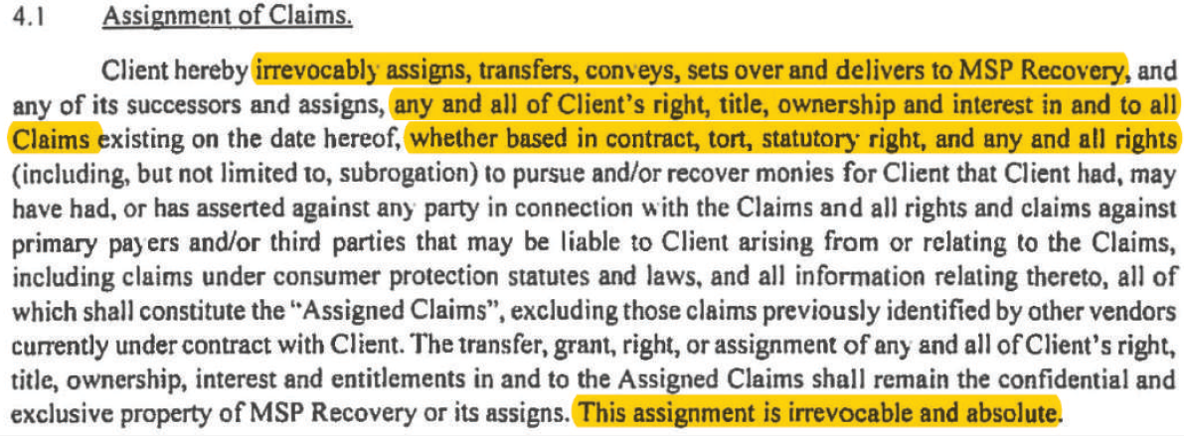
Assignment Agreements

Slide 44
MAO-MSO Recovery II, LLC, et al.
v. Mercury General - May 2018
In a landmark decision for MSP Recovery, the Court denied Mercury General’s motion to dismiss, notably holding that MSOs and IPAs, considered "first-tier" or "downstream" entities under the MSPA, would suffer the same injury as an MAO when a primary payer failed to pay or reimburse them, and as such these entities have the same ability to assert a private right of action under the statutes as MAOs as "secondary payers."

Slide 45
MSP Recovery Claims, Series LLC, et al.
v. Farmers Insurance Exchange - August 2018
Following the May 2018 Mercury General decision, the Court held that first-tier and downstream entities would suffer the same injury as MAOs when a primary payer filed to pay or reimburse them, and thus had standing to sue under the MSP Act’s private cause of action. Notably, after scrutinizing the MSP Act language, the Court rejected conflicting opinions, finding that the MSP Act’s private cause of action did not limit the types of entities that may bring suit.

Slide 46
MAO-MSO Recovery II, LLC v. GEICO - October 2018
In an October 11, 2018 Letter Order, Judge Grimm informed defendant GEICO that producing data directly to Plaintiffs would produce the same result as Plaintiff examining the electronic database pursuant to Rule 34(a)(1)(A), yet in a more efficient manner, exposing less confidential information, and that arguments of privacy and burdensome would not support defendant's objection.

Slide 47
MAO-MSO Recovery II, LLC v. GEICO
April 16, 2019
After numerous hearings, the Special Master in the matter, upon conversations with Judge Grimm, held that GEICO and all of its affiliates are to turn over all of their data to a third party vendor to match with MSP Recovery’s data to identify recoverable claims.
The parties have since hired Alvarez & Marsal and are working through this process.

Slide 48
MSPA Claims 1, LLC v. Tenet Fl. (11th Circuit 2019) - March 2019
The United States Court of Appeals for the Eleventh Circuit held that the MSPA Claims 1, LLC, assignment were valid:
“…MSPA has standing if (1) its ultimate assignor FHCP suffered an injury-in-fact, and (2) FHCP’s claims arising from that injury was validly assigned to MSPA. MSPA has shown both.”
“FHCP suffered an injury-in-fact when it had to wait seven months for appropriate reimbursement. And it validly assigned the right to vindicate that injury to La Ley, who in turn validly assigned it to MSPA. As a result, MSPA has standing.

Slide 49
MSPA Claims 1 v. Kingsway Amigo Ins. Co.,
(11th Cir. 2020)
MSP Recovery does not need to provide notice to a primary before seeking reimbursement under section 1395y(b)(3)(A).
The appellate court held that the MSP Act’s claims-filing provision (section 1395y(b)(2)(B)(vi)) does not impose a timeliness requirement with which government, or, an MAO, has to comply as prerequisite to filing suit to seek reimbursement for payments that it made on behalf of Medicare beneficiary.

Slide 50
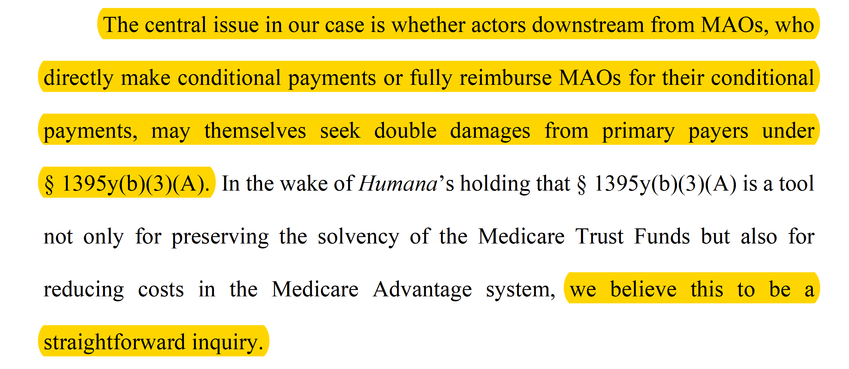
MSP Recovery v. Ace American Ins. Co. (11th Circuit 2020) September 2020

Slide 51
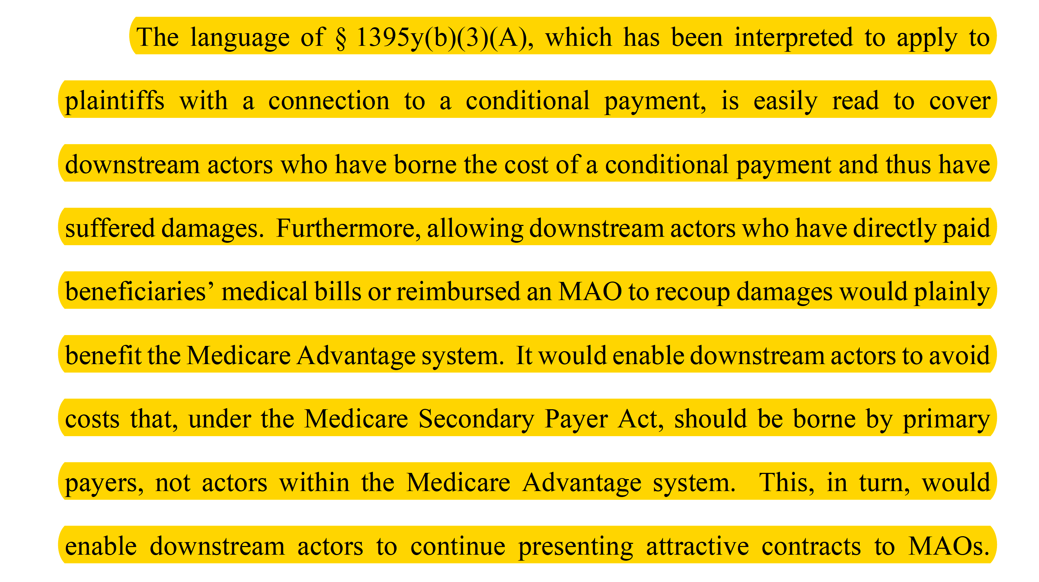
MSP Recovery v. Ace American Ins. Co. (11th Circuit 2020) September 2020

Slide 52
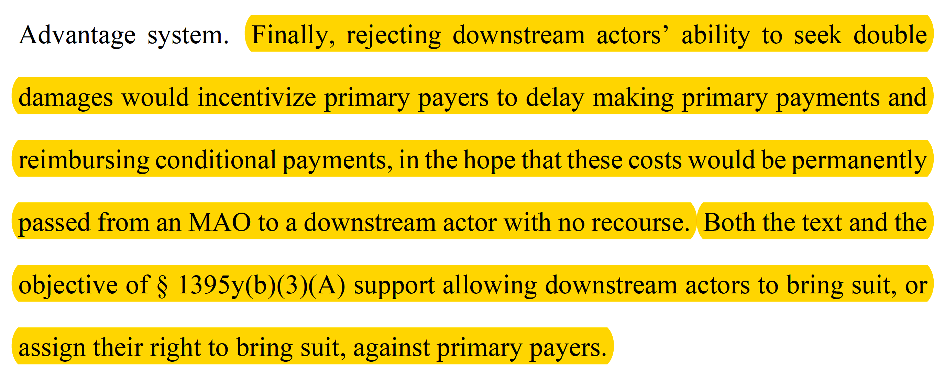
MSP Recovery v. Ace American Ins. Co. (11th Circuit 2020) September 2020

Slide 53
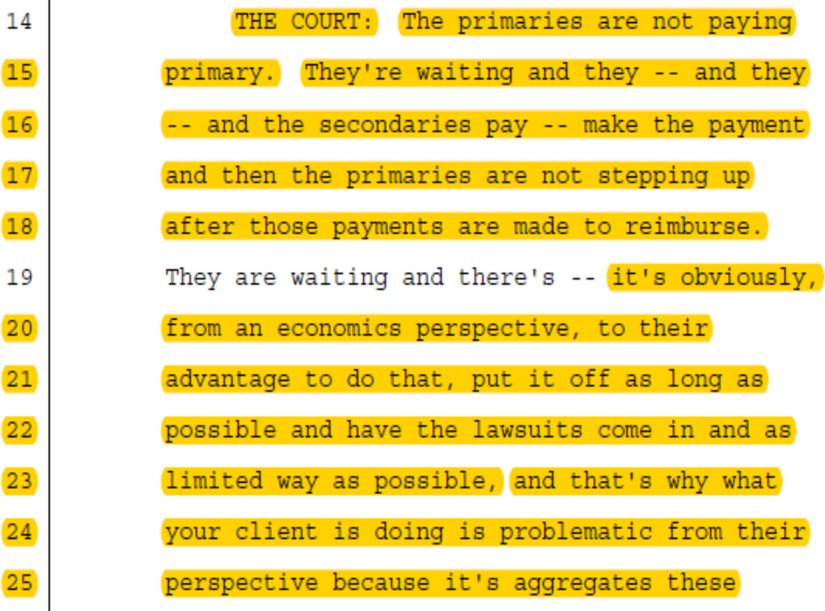
The Appellate Court’s View of The problem
Honorable John M. Walker, Jr. of the U.S. Court of Appeals in MSP Recovery Claims Series LLC v. Ace, Case No: 18-12139, 18-12139 2020 WL 5365978, transcript at pp.10-1:14-21 (11th Cir., September 10, 2020).

Slide 54
The Appellate Court’s View of The problem
Honorable John M. Walker, Jr. of the U.S. Court of Appeals in MSP Recovery Claims Series LLC v. Ace, Case No: 18-12139, 18-12139 2020 WL 5365978, transcript at pp.10-1:14-21 (11th Cir., September 10, 2020).

Slide 55
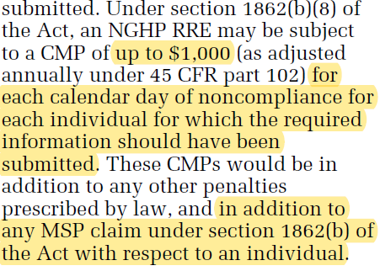

CMS’s View of the problem – Proposed New Rule (February 2020)
CMS recognizes that primary payers are NOT reporting pursuant to Section 111. They are strengthening their ability to issue penalties under the code.
CMS will begin imposing civil money penalties (“CMPs”) to enforce compliance with MSP reporting obligations.
The proposed penalty would be in addition to any MSP reimbursement obligations.
See Medicare Program; Medicare Secondary Payer and Certain Civil Money Penalties, 85 Fed. Reg. 32,8793 (Feb. 18, 2020) (to be codified at 45 C.F.R. pt. 402).

Slide 56


Paid v. Billed

Slide 57
Paid v. Billed
42 C.F.R. § 411.31 Authority to bill primary payers for full charges.
(a) The fact that Medicare payments are limited to the DRG amount, or the reasonable charge, reasonable cost, capitation or fee schedule rate, does not affect the amount that a primary payer may pay.
(b) With respect to workers' compensation plans, no-fault insurers, and employer group health plans, a provider or supplier may bill its full charges and expect those charges to be paid unless there are limits imposed by laws other than title XVIII of the Act or by agreements with the primary payer.

Slide 58
Paid v. Billed
§ 422.108 Medicare secondary payer (MSP) procedures.
(f) MSP rules and State laws. Consistent with § 422.402 concerning the Federal preemption of State law, the rules established under this section supersede any State laws, regulations, contract requirements, or other standards that would otherwise apply to MA plans. A State cannot take away an MA organization's right under Federal law and the MSP regulations to bill, or to authorize providers and suppliers to bill, for services for which Medicare is not the primary payer. The MA organization will exercise the same rights to recover from a primary plan, entity, or individual that the Secretary exercises under the MSP regulations in subparts B through D of part 411 of this chapter.

Slide 59
Paid v. Billed
42 U.S.C. § 1395w-22 – Benefits and beneficiary protections
(4)Organization as secondary payer Notwithstanding any other provision of law, a Medicare+Choice organization may (in the case of the provision of items and services to an individual under a Medicare+Choice plan under circumstances in which payment under this subchapter is made secondary pursuant to section 1395y(b)(2) of this title) charge or authorize the provider of such services to charge, in accordance with the charges allowed under a law, plan, or policy described in such section—
(A) the insurance carrier, employer, or other entity which under such law, plan, or policy is to pay for the provision of such services, or
(B) such individual to the extent that the individual has been paid under such law, plan, or policy for such services.

Slide 60
Paid v. Billed – Courts Agree
Humana Inc. v. Medtronic Sofamor Danek USA, Inc., 133 F. Supp. 3d 1068, 1078 (W.D. Tenn. 2015)
The court in Medtronic agreed with Humana’s argument that the MAOs have the right to bill primary plans. For clarity, the quotes below are taken directly from the Medtronic opinion and Humana’s briefing in that matter. As the court did not give a lengthy analysis and merely agreed with Humana’s arguments, it is necessary to read the relevant portion of Humana’s brief.

Slide 61
Paid v. Billed
Medicare Advantage has A Right-To-Charge 42 U.S.C. § 1395w-22(a)(4)
“Second, §1395w-22(a)(4) states an MAO may “charge or authorize the provider of such services to charge, in accordance with the charges allowed under a law, plan, or policy.” Applicable regulations have defined the term “charge” to mean “bill.” See 42 CFR § 422.108. Under applicable regulations, “[t]he MA organization may bill, or authorize a provider to bill, other individuals or entities for covered Medicare services for which Medicare is not the primary ; (2) The Medicare enrollee, to the extent that he or she has been paid by the carrier, employer, or entity for covered medical expenses.” 42 C.F.R. § 422.108(d). The MA Organization clearly has the right to bill the primary plan under Section 1395w22(a). If the MA Organization cannot then collect on those bills, this provision would be rendered meaningless.”

Slide 62
Paid v. Billed
Bio-Medical v. Central States, 656 F.3d 277 (6th Cir. 2011)
“Double damages must be at least enough such that the expected value of the litigation, after subtracting Medicare’s anticipated recovery, will be greater than zero. If this were the only consideration, we would hold that the reference point for double damages is the amount the private insurer would have paid, rather than the amount paid by Medicare, because the former usually exceeds the latter . . . .

Slide 63
Paid v. Billed
MSPA Claims 1, LLC v. Ocean Harbor Cas. Inc., Case No. 2015-1946 CA 06 (Fla. 11th Cir. Ct. 2016)
“As the issues presented will be resolved by the review of data and by examining and interpreting Florida’s No-Fault law and the MSP Law, there will be no need for fact specific individual analysis of intent or causation, and damages will be calculated based upon the total fee-for-service amounts.”
“There is no need for a fact-specific individual analysis of intent or causation, and damages will be calculated based upon the total fee-for-service amounts associated with the payments made on behalf of an enrollee by an MAO.”

Slide 64
How We Maximize Recoveries

Slide 65
MSP Recovery – Client Roster

Slide 66
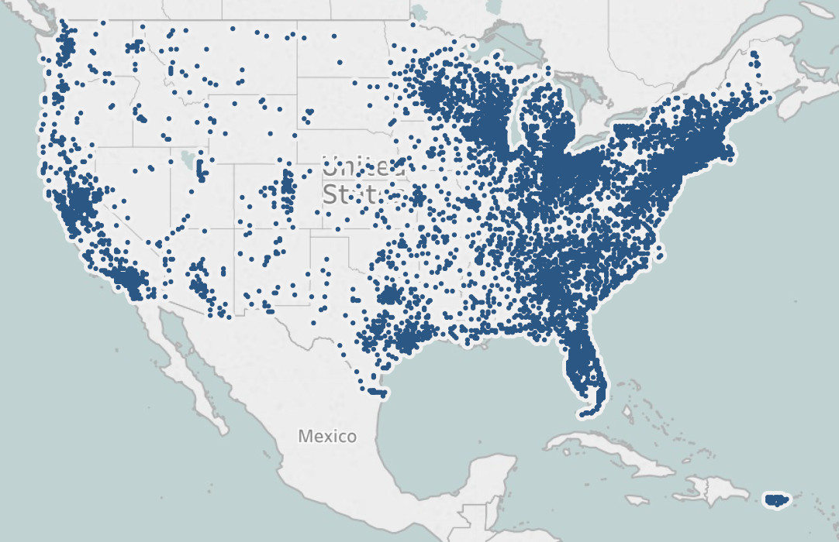
MSP Recovery – Assigned Claims
Data Related to Assigned Claims in all 50 states
Each dot represents a zip code where MSP Recovery has been assigned claims.

Slide 67
Data Sources Some Examples of Many, Many More
FDA Device Recall
Traffic Crash Reports
NAIC
My Ability
CMS NPI
NDC
FDA Drug Enforcement
MAO Claims Data
Property Records
FDA Device Enforcement
ISO
CMS Laboratory Fee Schedule
Fair Health
CMS Durable Medical Equipment Fee Schedule
CMS Ambulance Fee Schedule
CMS Physicians Fee Schedule

Slide 68
My Ability
ABILITY® Network is a leading healthcare information technology company helping providers and payers simplify the administrative and clinical complexities of healthcare through innovative applications and data analytics.
They provides a Web Service API which is a enterprise service that provides real-time and batch eligibility processing web service, allowing users to process standard eligibility transactions with numerous payers and electronic trading partners.
Main Fields
Insurance Type
HIC Number
Enrollment (Date of Accident)
Contract / Plan #
Address
Record Type
'12 Medicare Secondary Working Aged Beneficiary or spouse with Employer Group Health Plan'
'14 Medicare Secondary No-Fault insurance including auto is primary’
'15 Medicare Secondary Workers’ Compensation’
'43 Medicare Secondary Disabled Beneficiary Under Age 65 with Large Group Health Plan'
'47 Medicare Secondary other liability insurance is primary’
'OT MA plans that offer Prescription Drug Coverage’
'PR Preferred Provider Organization’
'WC Workers’ Compensation Medicare Set-aside Arrangement’
'HN HMO Medicare Risk’
My Ability Website: https://abilitynetwork.com/

Slide 69
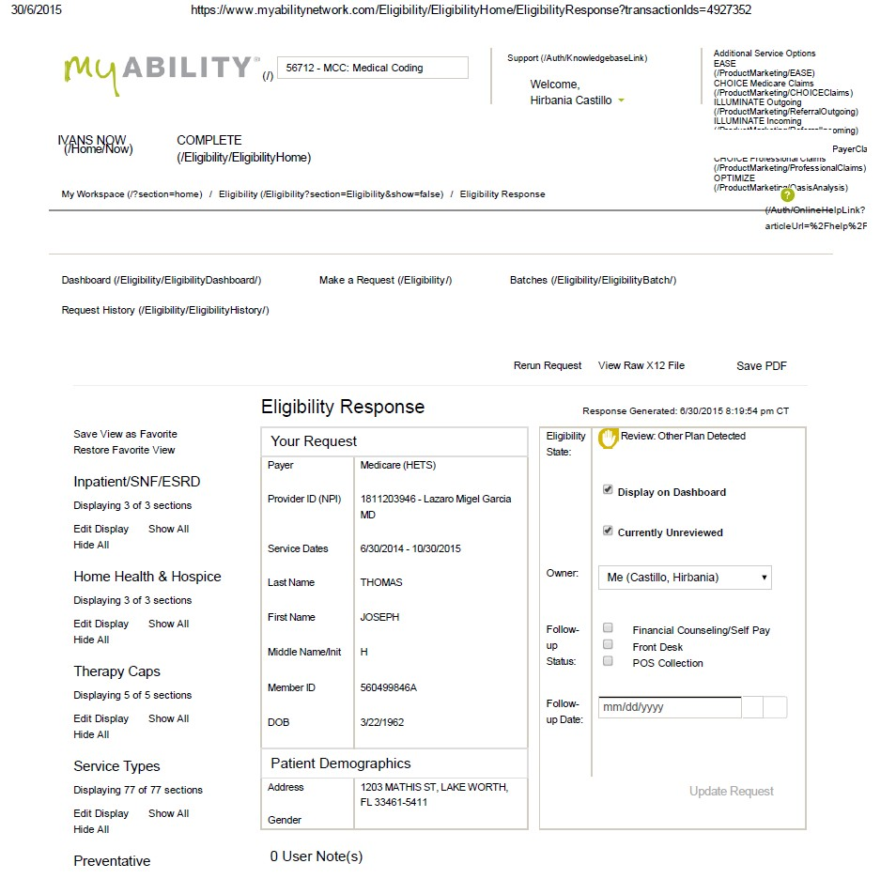
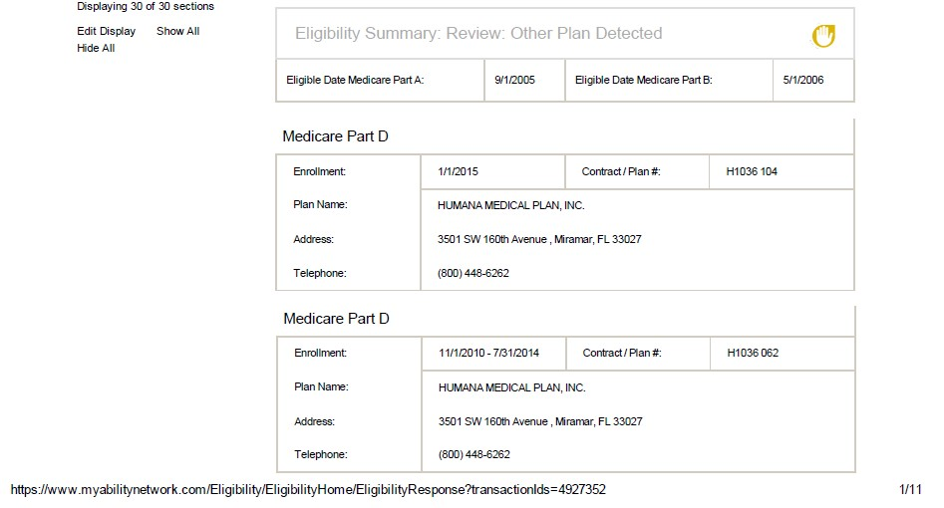
My Ability (Sample)

Slide 70
Traffic Crash Reports
Each State’s Department of Highway Safety and Motor Vehicles (DHSMV).
Primary Data Fields:
Report Number
Crash Year
Crash Date
Person First Name
Person Last Name
Date of Birth
Person Address
Vehicle Owner Name
VIN
Vehicle Make
Vehicle Model
Driver License Number
Injury Severity
Taken to EMS
Person City
Person State
Person Type (Passenger, Pedestrian, Driver)
Person Location in Vehicle
Insurance Company
Policy Number
Florida DMV Website: https://www.flhsmv.gov

Slide 71
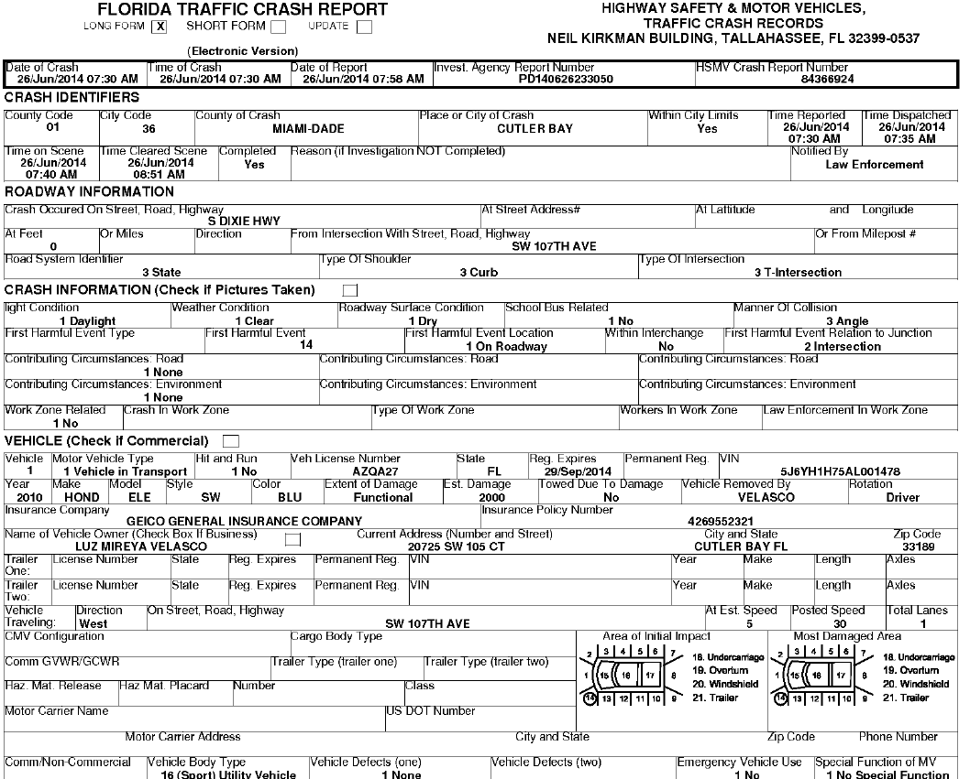
Traffic Crash Reports (Sample)

Slide 72
The Shell Game

Slide 73
Primary Payer – Reported v. Non-Reported Instances.

Slide 74
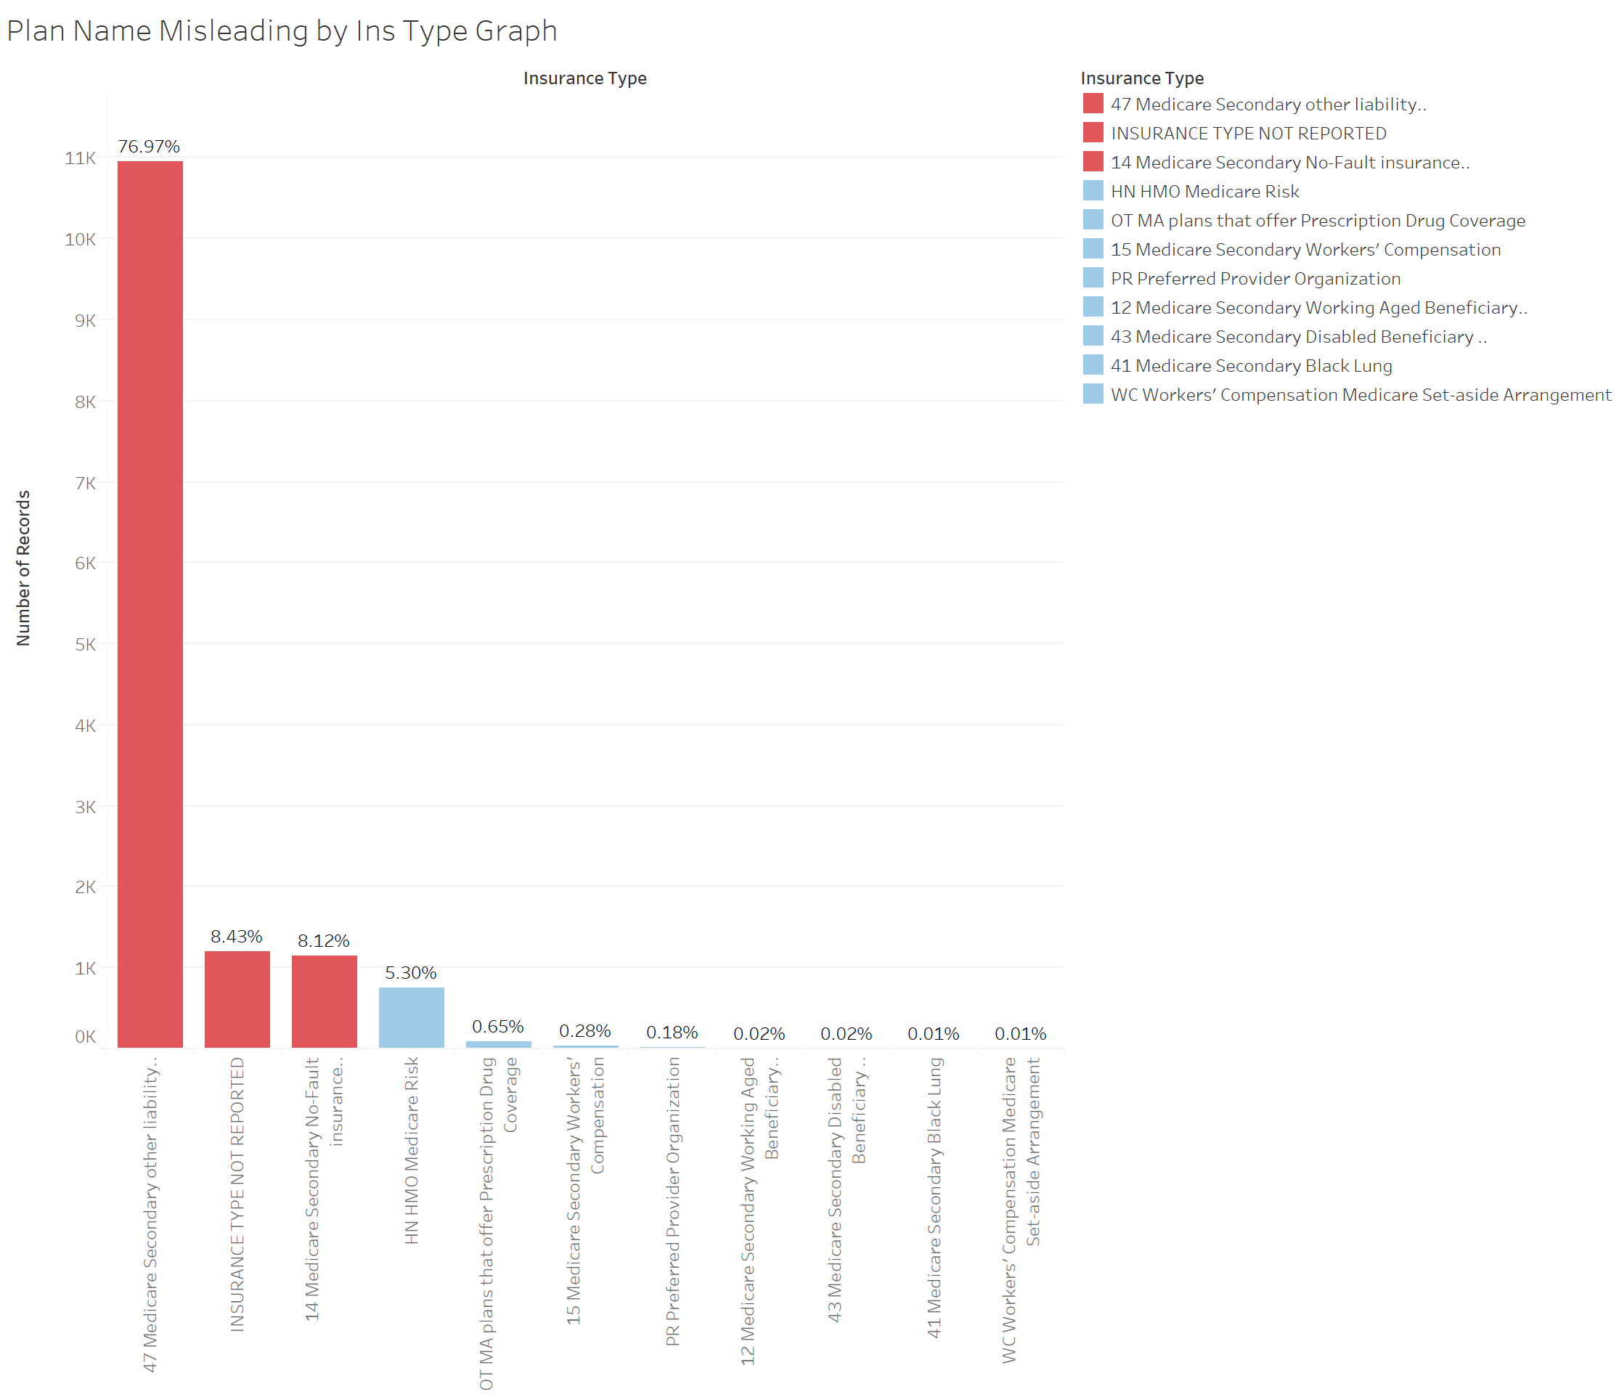
Primary Payers Report Through Different Entities.

Slide 75
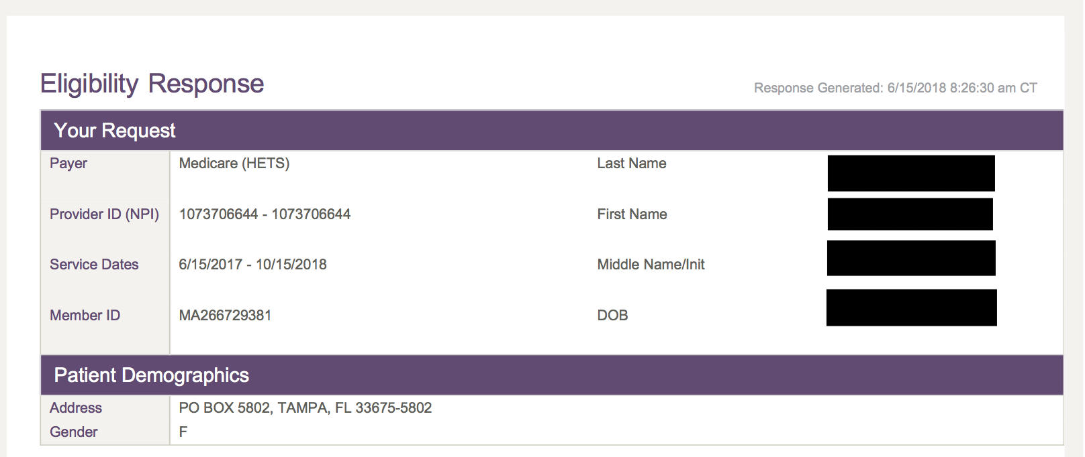
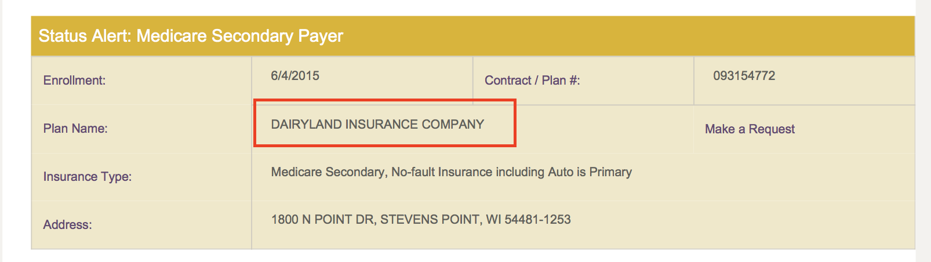
Dairyland
Notes:
MSP determined whether the RRE that reported its responsibility pursuant to Section 111 was in fact the RRE that had primary payer responsibility. In this case, MSP identified that Dairyland improperly reported on behalf of one of its corporate siblings, Peak, in violation of Section 111.

Slide 76
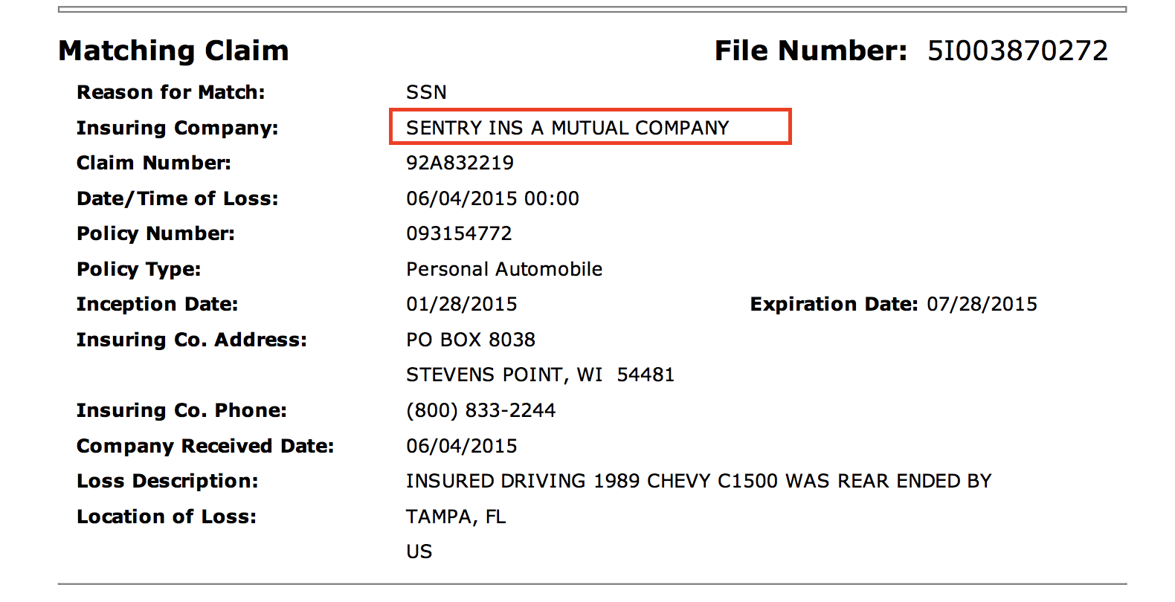
Dairyland – Reports as Sentry

Slide 77
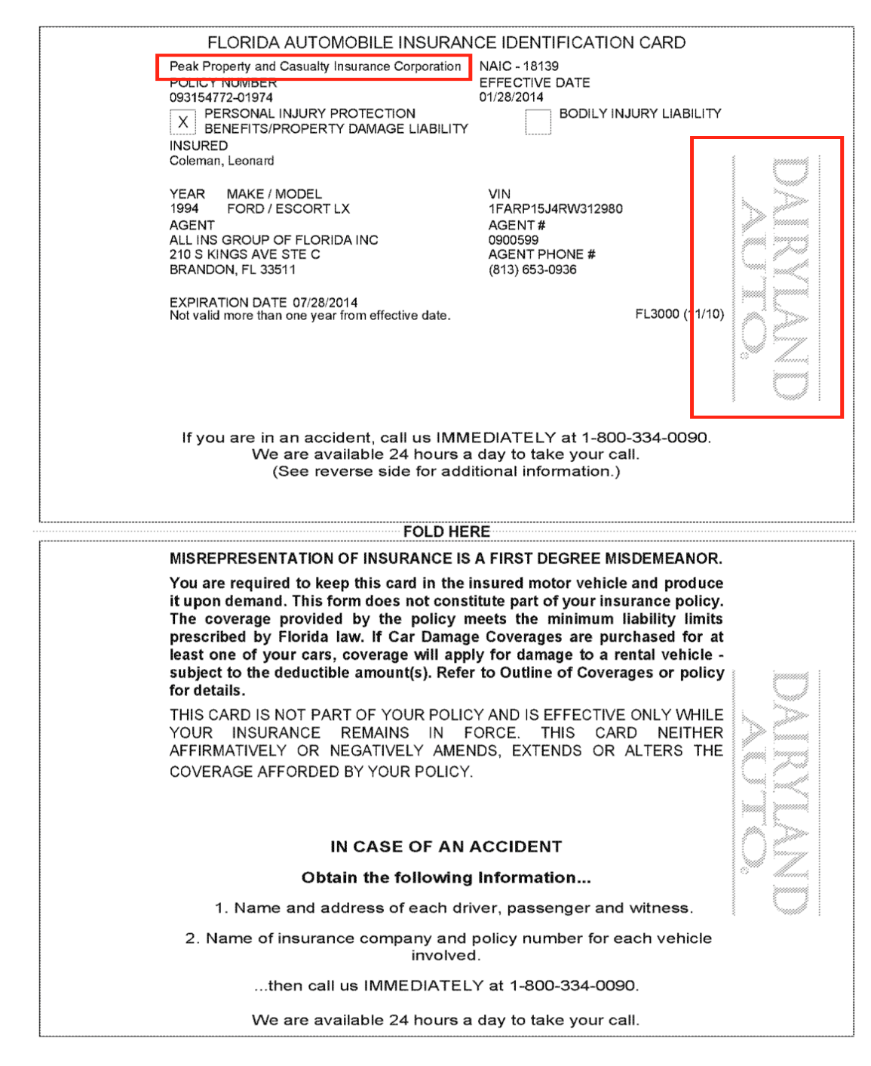
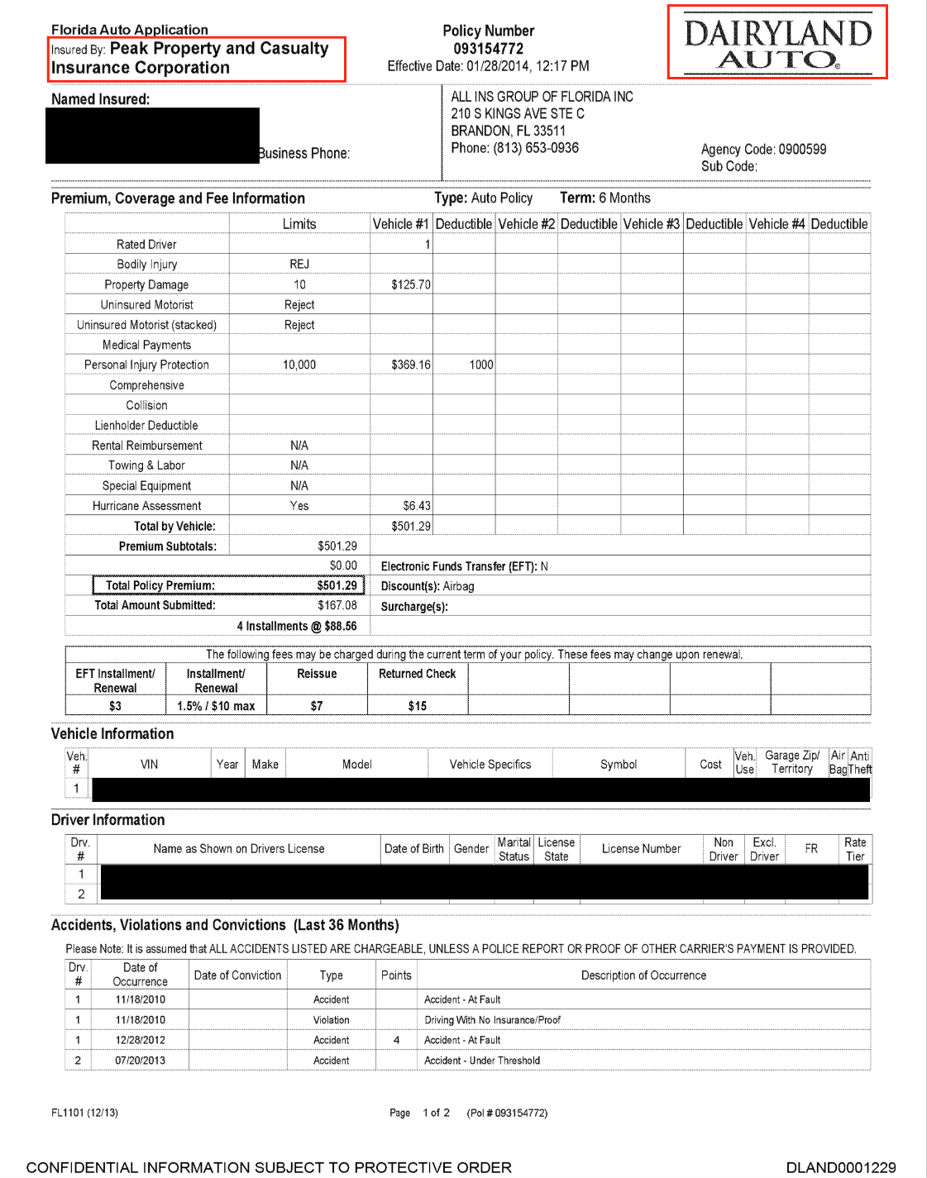

Slide 78
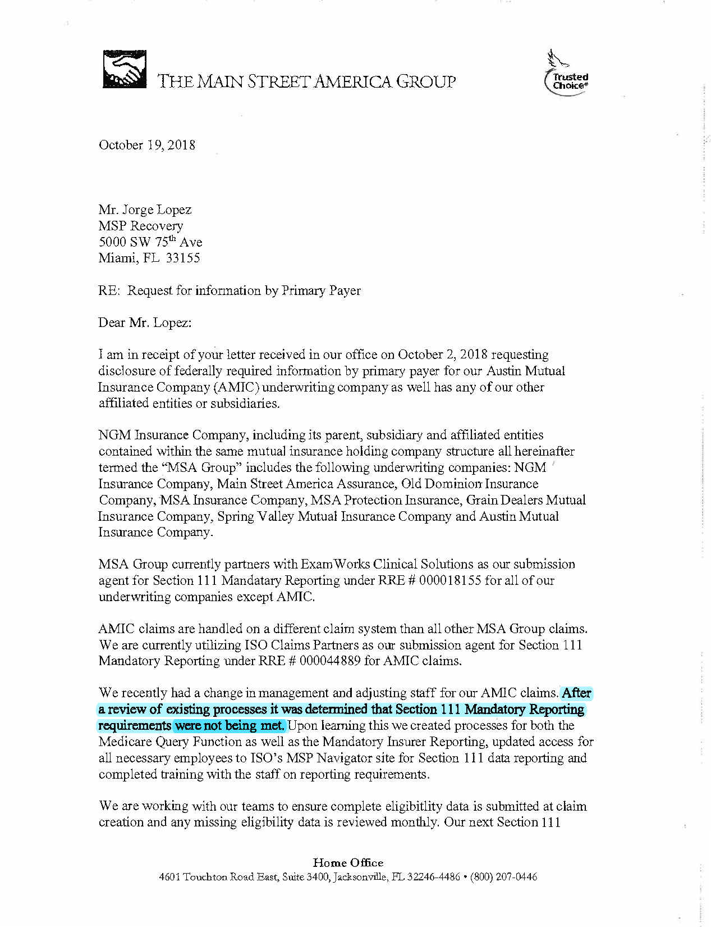
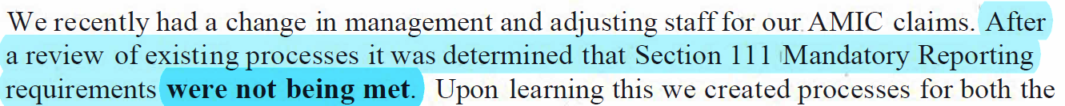

Slide 79
How We Identify Recoveries

Slide 80

Data Hits Example

Slide 81
Crash Report Matches:
Sample
MSP Primary Asset | Insurance Company | Matches
SMCR-SMCR |  | 60
SMCR-SMCR | GEICO GENERAL INSURANCE COMPANY | 14
SMCR-SMCR | STATE FARM GROUP | 61
SMCR-SMCR | ALLSTATE INSURANCE GROUP | 25
SMCR-SMCR | PROGRESSIVE INSURANCE GROUP | 20
SMCR-SMCR | STATES SELF-INSURERS RISK RETENTION GROUP | 3
SMCR-SMCR | LIBERTY MUTUAL GROUP | 3
SMCR-SMCR | NATIONWIDE CORPORATION GROUP | 12
SMCR-SMCR | HARTFORD CASUALTY INSURANCE COMPANY | 6
SMCR-SMCR | USAA CASUALTY INSURANCE COMPANY | 6
SMCR-SMCR | Travelers Group | 4
SMCR-SMCR | SAFECO INSURANCE COMPANY OF AMERICA | 3
SMCR-SMCR | METROPOLITAN GROUP | 1
SMCR-SMCR | Infinity Property & Casualty Insurance Group | 2
SMCR-SMCR | Auto Club Enterprises Insurance Group | 3
SMCR-SMCR | ERIE INSURANCE GROUP | 8
SMCR-SMCR | FARM BUREAU GROUP | 5
SMCR-SMCR | Westfield Insurance Company | 7
SMCR-SMCR | GRANGE INSURANCE GROUP | 5
SMCR-SMCR | HANOVER INSURANCE COMPANY | 1
SMCR-SMCR | Owners Insurance Company | 6
SMCR-SMCR | UNITED SERVICES AUTOMOBILE ASSOCIATION GROUP | 2
SMCR-SMCR | Esurance Insurance Company | 1
SMCR-SMCR | MERCURY GENERAL GROUP | 1
SMCR-SMCR | AUTO CLUB GROUP INSURANCE COMPANY | 1
SMCR-SMCR | FARMERS INS GRP | 2

Slide 82





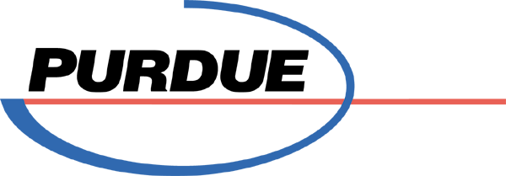



Defendants

Slide 83
Opioids

Slide 84
“Its like people are addicted… .”
Evidence
Our Data
Individuals in Ohio who were prescribed opioids and were later treated for drug dependency.
Year | Percentage
2009 | 8.6%
2010 | 30.8%
2011 | 20%
2012 | 11.7%
2013 | 21.5%
2014 | 21.3%
2015 | 49.7%
2016 | 39.7%
2017 | 22.7%

Slide 85
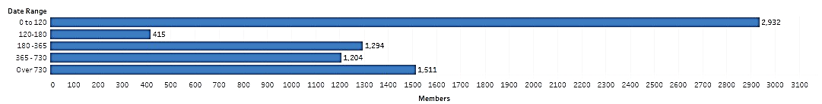
Defendant Falsehood Addiction can be easily identified and managed
Time frame between first Opioid prescription and Opioid dependence diagnosis.
Date Between Ingestion and Diagnosis of Dependency

Slide 87
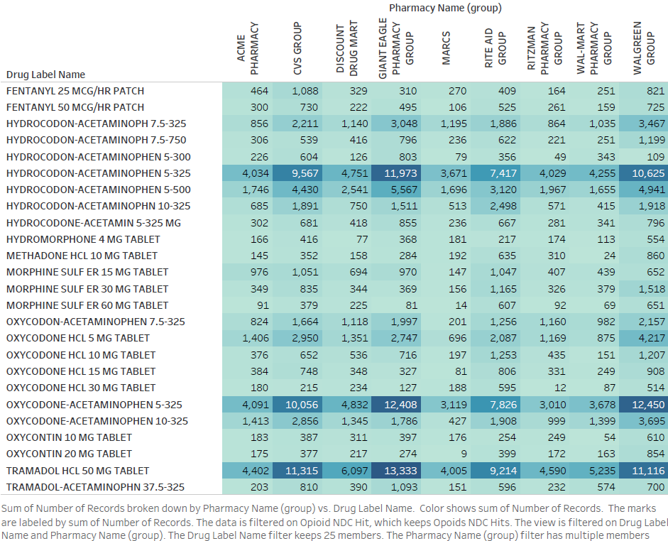
Opioid Dispensing: By Large Pharmacy Groups and Types of Opioids

Slide 88
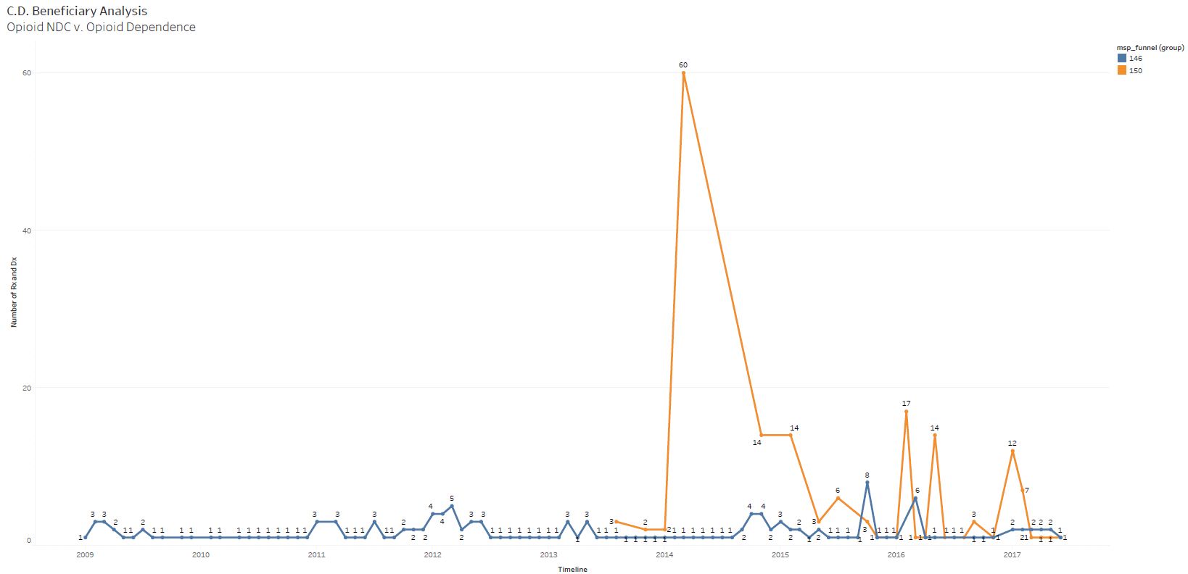
C.D.’s Opioid Addiction Timeline

Slide 89
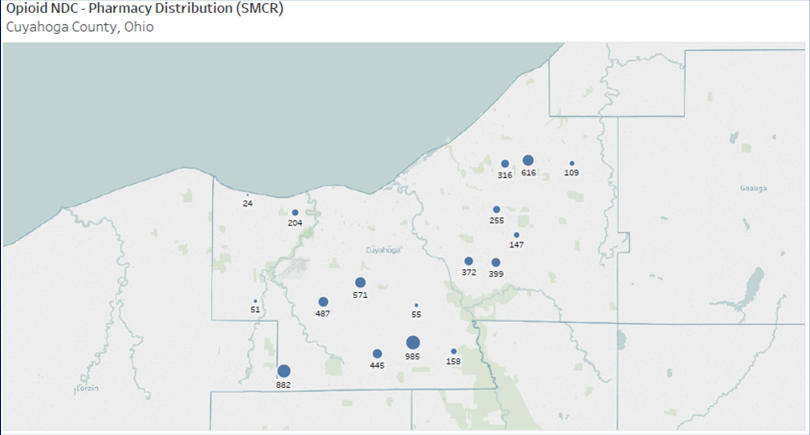
Some Examples of MSP Data
Claims data between January 1, 2009 and June 30, 2017

Slide 90
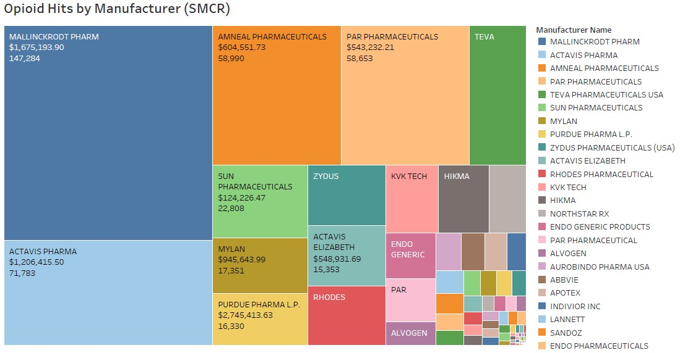

Slide 91
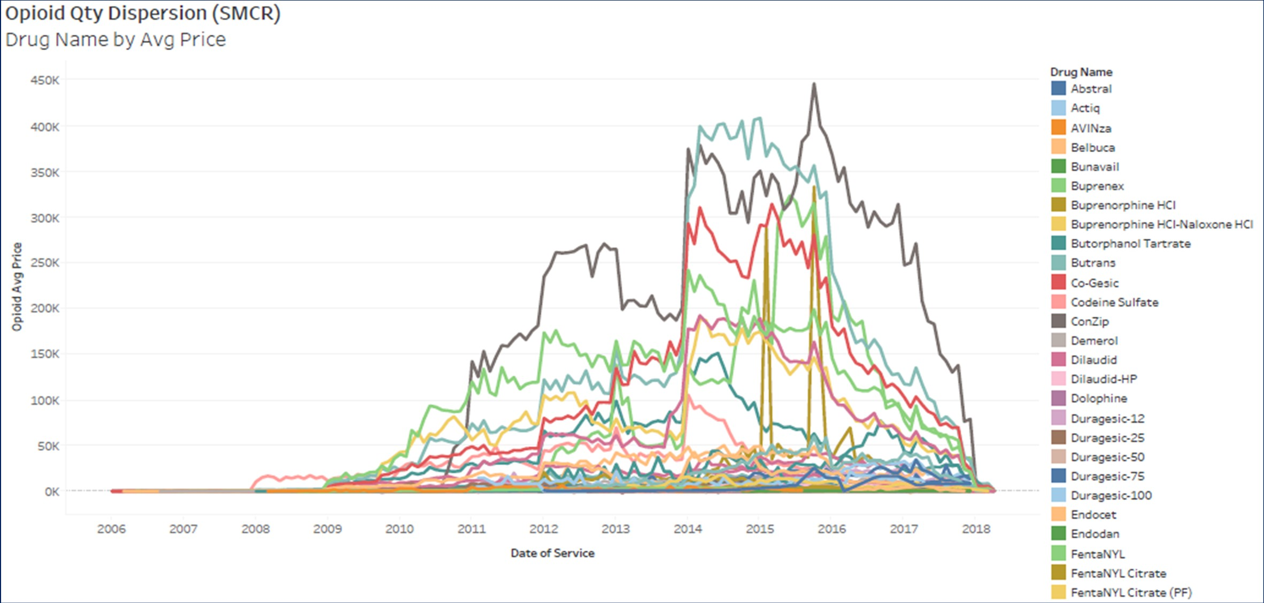

Slide 92
Zantac

Slide 93
Preliminary Analysis
Zantac

Slide 94
Valsartan

Slide 95
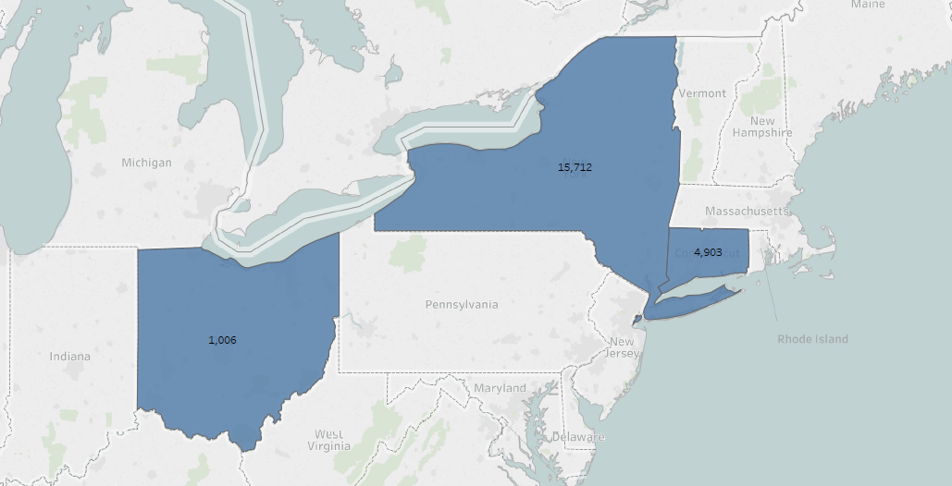
Valsartan by State Map

Slide 96
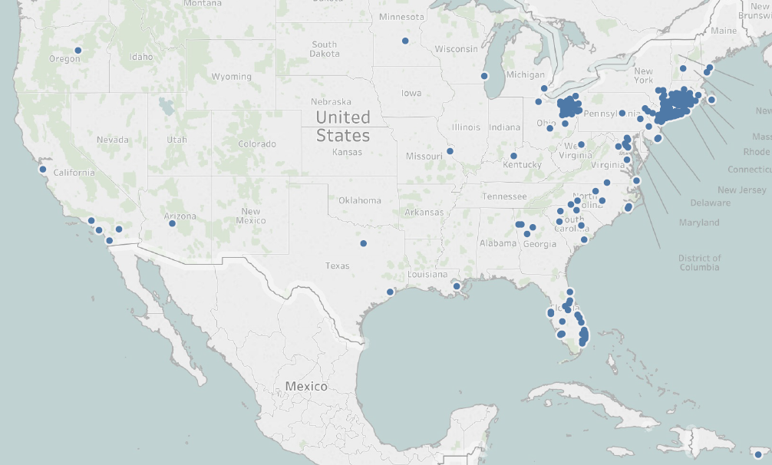
Valsartan by Member Address

Slide 97
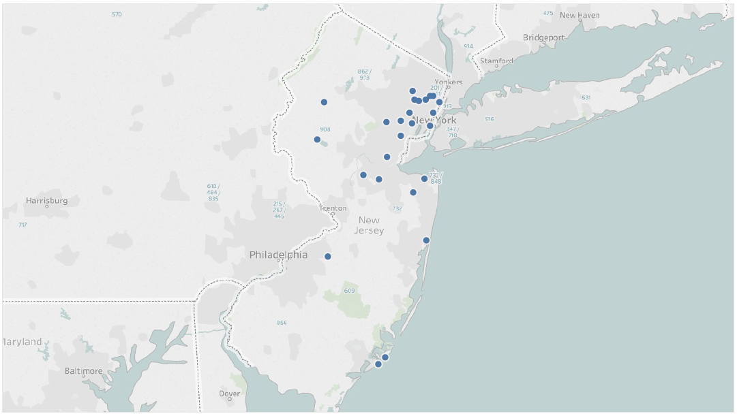
Valsartan by Member Address NJ Only

Slide 98
Insulin

Slide 99
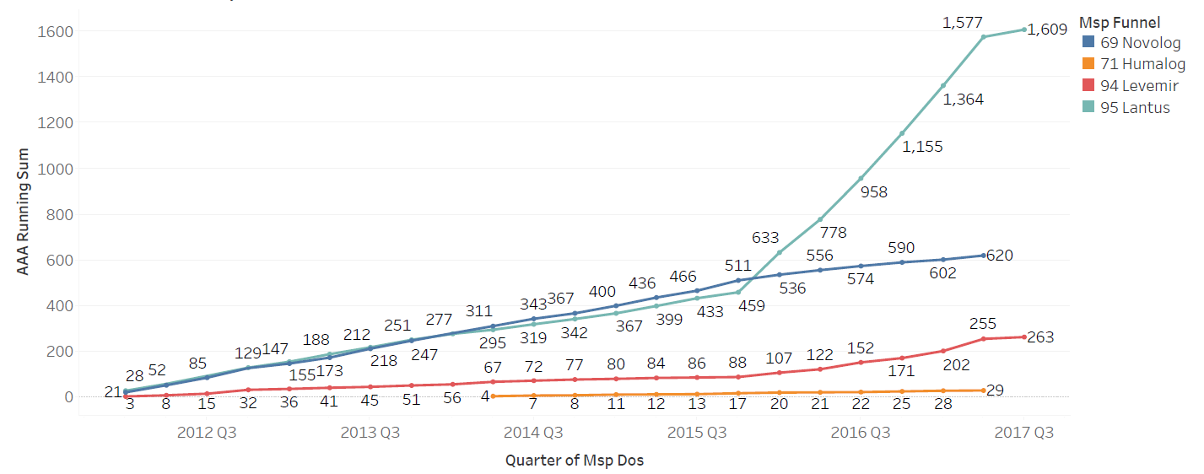
Insulin – by Quarter

Slide 100
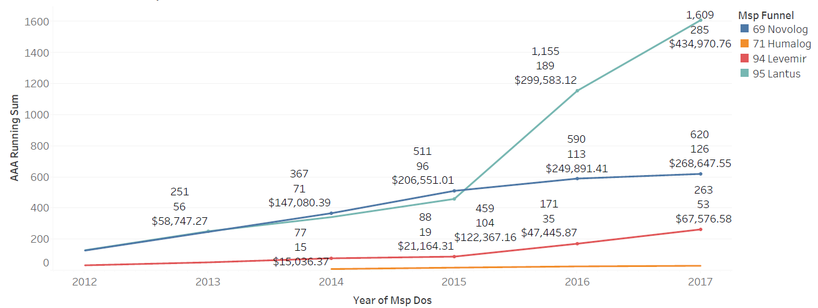
Insulin – Running Sum

Slide 101
Data Security

Slide 102




MSP Recovery HIPAA Team
Chief Compliance Officer and Team
Chief Compliance Officer
Alexandra Plasencia, Esq., CHP, MBA, CHPC
Former General Counsel for nationwide healthcare provider group
Deputy Compliance Officer
Naisleth Rodriguez, Esq., CHP, MBA
Outside Counsel Compliance Advisor
Gino Moreno, Esq., CHP
General Counsel
Jorge Lopez, Esq.
IT Security Officer and Team
All employees are provided HIPAA training.
Maintain outside privacy consultants and personnel to audit and advise.
HITRUST Certified

Slide 103

Security Robust & Extensive
MSP Recovery uses
Data Integrity
Audit Controls
Encrypted Data Transfers
Data Segregation
Amazon’s data encryption services use hardware-accelerated Advanced Encryption Standard (AES)-256 symmetric keys.
https://d1.awsstatic.com/whitepapers/compliance/AWS_HIPAA_Compliance_Whitepaper.pdf

Slide 104
Security Robust & Extensive
256-bit encryption for all protected health information (“PHI”) data:
“It would take 50 supercomputers checking a billion keys per second 3x1051 years to crack 256-bit encryption.”
https://www.sharefile.com/resources/reduce-your-risk-the-basics-of-encryption-and-compliance

Slide 105

Security Robust & Extensive
MSP Recovery uses

Slide 106
Extensive Auditing
MSP Recovery is assessed periodically by Skoda Minotti and receives unqualified opinions of its operating effectiveness and controls relevant to security, processing integrity, and confidentiality.

Slide 107


Preventative Controls
MSP Recovery uses to identify and prevent data risks.
The Coalition's team includes “technology entrepreneurs and executives that helped build Cloudflare, Look-out and OpenDNS, former members of the US Intelligence Community and cyber insurance innovators.”
https://www.thecoalition.com/announcements/leading-global-insurers-back-coalition-to-solve-cyber-risk-2017-dec-05

Slide 108
Discover. Recover.
www.msprecovery.com

